Slide 1
HealthCare Data
Sakshi Gunjal

Slide 2
INTRODUCTION
This is a publicly available healthcare Data od patient wait list and this dataset contains two types
Of data categories.
In-Patient:
A Patient who stays in hospital while under treatment.
Out-Patient:
A Patient who receives medical treatment without being admitted to a hospital.

Slide 3
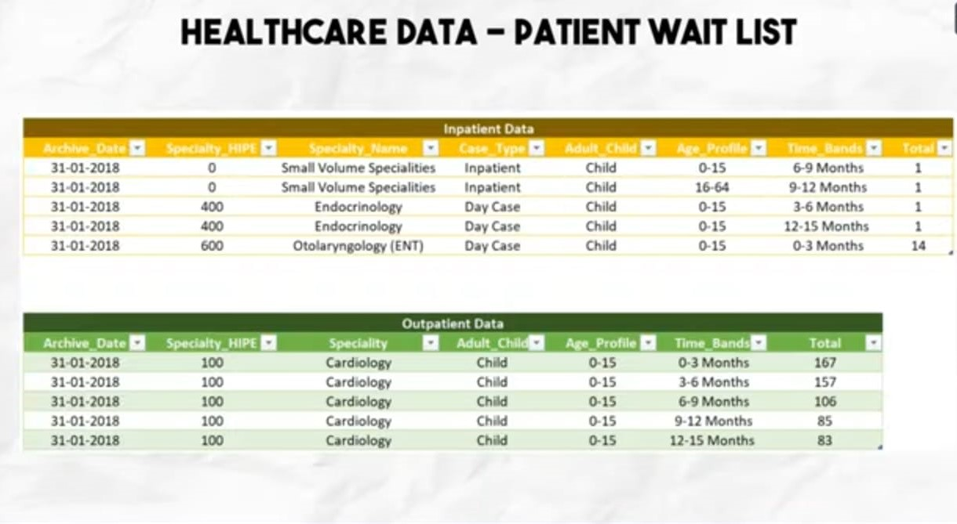
Content of Data Set

Slide 4
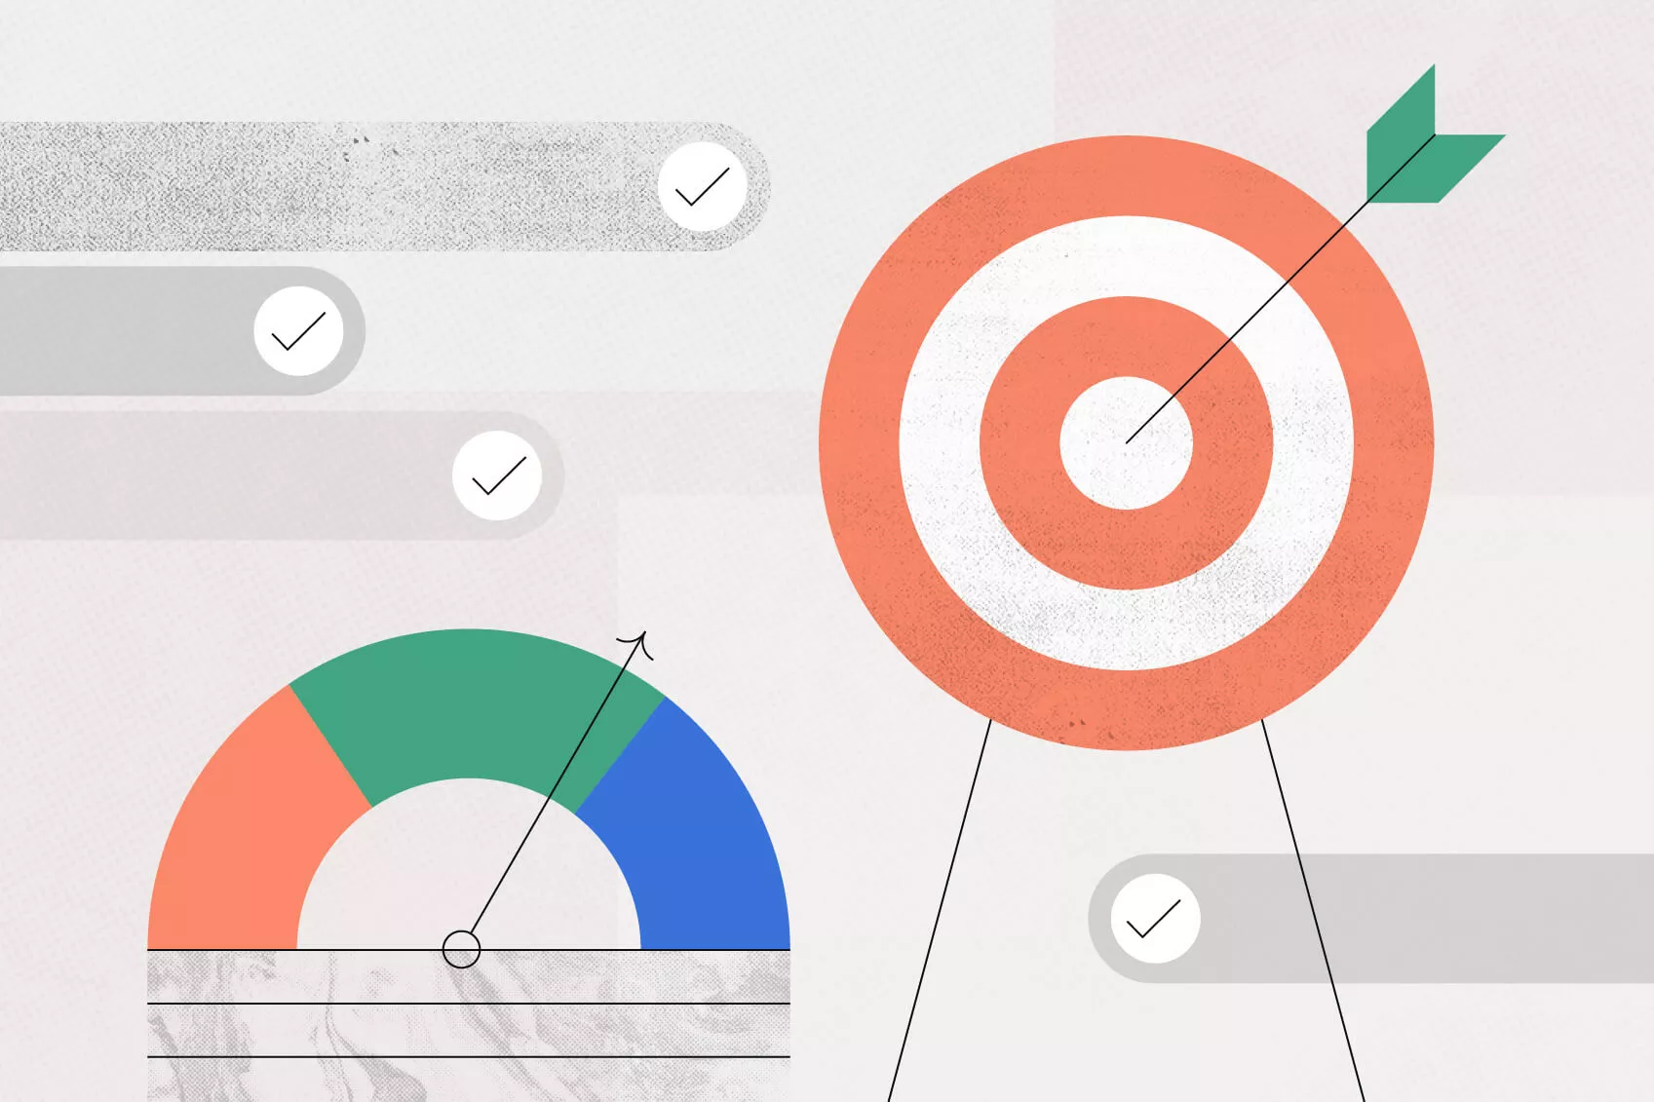
OBJECTIVES
Project Goal:
Track the current status of patient waiting list.
Analyze historical monthly trend of waiting list in In-patient & Out-patient categories.
Detailed specialty level & age profile analysis.
Data Scope:
2018 – 2021
Metrics Required:
Average & Median Waiting List.
Current total wait list.
Views Required:
Summary Page.
Detailed Page for Granular Analysis.

Slide 5
WORK FLOW OF PROJECT
Requirement Gathering
Data Collection
Transformation & Modelling
Data Visualization Blueprint
Dashboard Layout & Design
Testing

Slide 6
STEP 1 : Requirement Gathering Phase.
The first one is to identify stakeholder now ironically enough so in this step we would have to determine our primary stakeholder and establish a point of contact who might be the leader or domain expert who will eventually use our dashboard.
Understand business objectives through call or meeting you should get an outline of goals from the entire end over asking open end questions will help us to give more insight to understand the data and how this dashboard will help to achieve a specific business goal.
High level data study we have to cover specific topics like data sources, column description, data type, volume & frequency & data Quality.
Define scope this is to discuss key metrics KPI’S or deployment timelines, calculations,time frame and scope with the stakeholders and to document everything which will help to set the expectation and avoid any future disagreement.

Slide 7
STEP 2 : Data Collection
Data collection is collecting data from multiple sources and importing them into the power bi environment over all we have 200+ data connectors available in power bi.
So in this HealthCare Dashboard project we have used the FOLDER data connector which will host all the files required for the dashboard.
So to used FOLDER connector the reason is I am using the Data of 2018 – 2021
So I required 4 excel worksheet in one folder for each patient data of In-Patient and Out-Patient.

Slide 8
STEP 3 : Data Transformation & Modelling
Here we just have to go in our transform tab and need to check our data and preview our rows and columns.
The transformation I have made is data types, replacing values, removing duplicates, etc.
The next step which I did is I club both my data in-patient and out-patient together so that I will have a single data which I have to used for my visualization purposes.

Slide 9
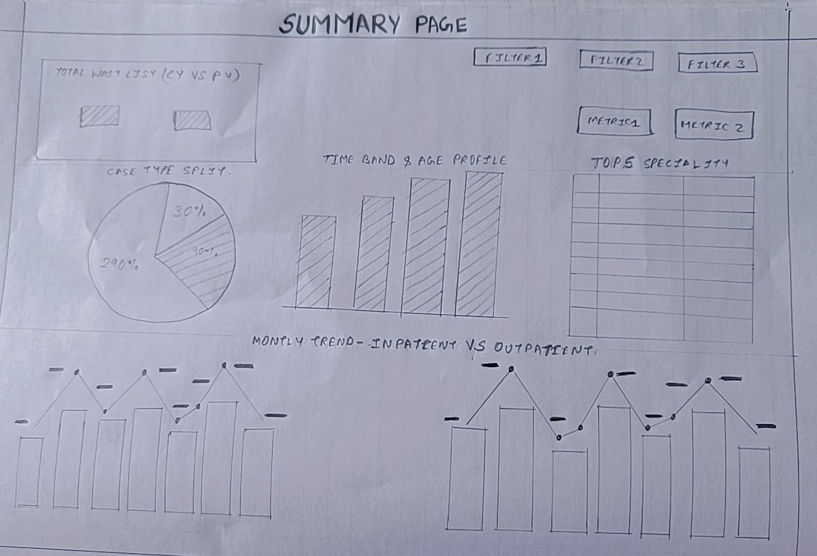
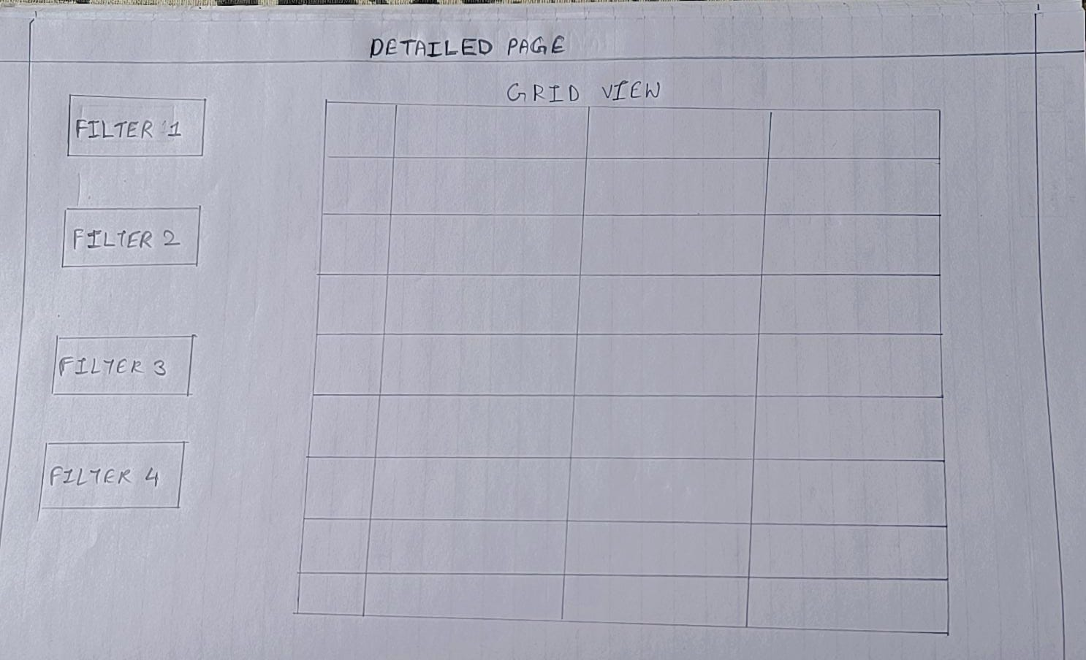
STEP 4 : Data Visualization & Blueprint
Blueprint is discussing the blueprint of the entire dashboard and finalizing a structure
It just a high level idea of how the visual will look like, As we required two pages.
SUMMARY PAGE
DETAILED VIEW PAGE

Slide 10
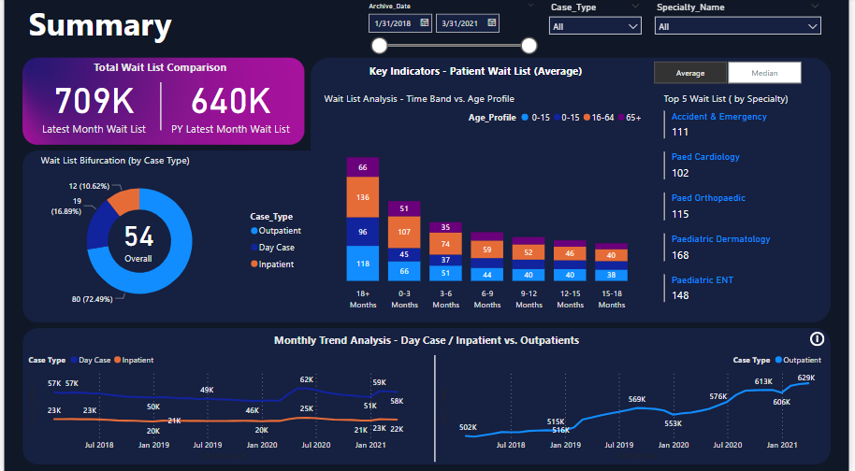
DASHBOARD – SUMMARY PAGE

Slide 11
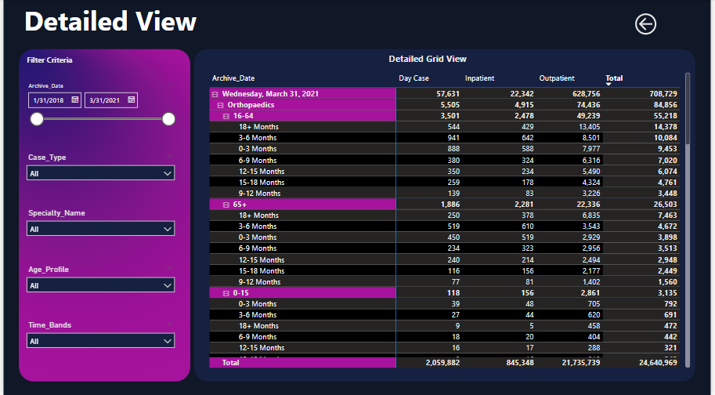
DETAILED PAGE

Slide 12
THANKYOU

